Slide 1
Chinook Music Store
Project
Lokesh Sharma

Slide 2

INTRODUCTION

Slide 3
INTRODUCTION
OUR COMPANY
Chinook, a leading brand in the physical music record sector, provides entertainment to a global audience. With an extensive range of music styles, Chinook serves music lovers worldwide through its international service points, ensuring access to diverse musical genres across various regions.

Slide 4
PROBLEM STATEMENTS
MARKET AND CUSTOMER SEGMENTATION
DATA COLLECTION AND CLEANING
DESCRIPTIVE ANALYSIS
Gather and clean sales data, ensuring consistency in product details, customer demographics, and sales figures
Summarize total sales, customer demographics, and product performance to identify top-selling genres, artists, and tracks.
Segment sales by region and customer behavior to identify strong markets and target audiences.Examine seasonal sales trends, growth or decline patterns, and factors influencing sales performance

Slide 5
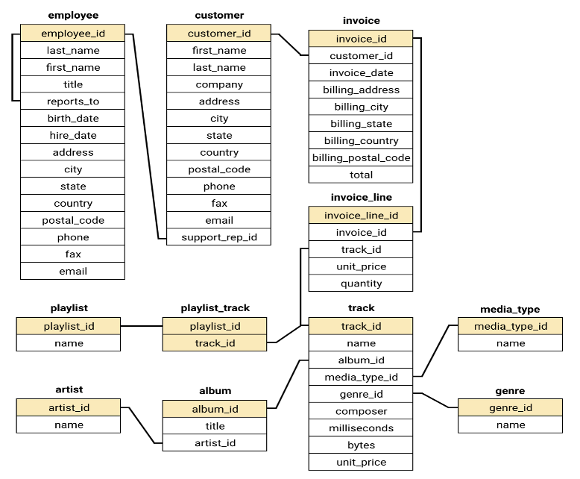
DATA OVERVIEW
The provided data for Chinook music store consists of 11 tables, which include:
Albums Table: Contains details about 251 music albums.
Artists Table: Lists information about 130 artists.
Genres Table: Contains data on 25 music genres.
Customers Table: Holds information about 59 customers across 24 countries.
Invoice Table: Includes transaction data for each customer.

Slide 6
METHODOLOGY
STEP-1 (DATA SCHEMA)
STEP-2(DATA VISUALIZATION)
The database consists of tables for Albums, Artists, Genres, Customers, and Invoices, with relationships linking sales data to customers, albums, and genres, enabling efficient analysis.
Simple queries were used to explore data, highlighting areas for deeper analysis like top albums, customer behavior, and genre trends.
STEP-3(DATA CLEANING)
STEP-4(PROBLEM SOLVING)
Cleaned and prepped data by handling missing values using COALESCE, ensuring reliable analysis.
Used advanced queries to uncover patterns like churn rate and customer segmentation, providing valuable business insights.

Slide 7
CHURN RATE ANALYSIS
Churn Rate Overview:
Overall Churn Rate: 19.88% (1 in 5 customers leaves annually).
Yearly Churn Pattern:
2018: 2 churned customers
2019: 4 churned customers
2020: 5 churned customers
Increasing Trend: Yearly churn is rising, indicating growing customer attrition
Recommendations:
Implement loyalty programs and personalized offers to encourage repeat business and strengthen customer loyalty.
Gather customer feedback to identify pain points and address the reasons why customers leave.
Focus on engaging new customers early with clear communication, support, and incentives to build lasting relationships.

Slide 8
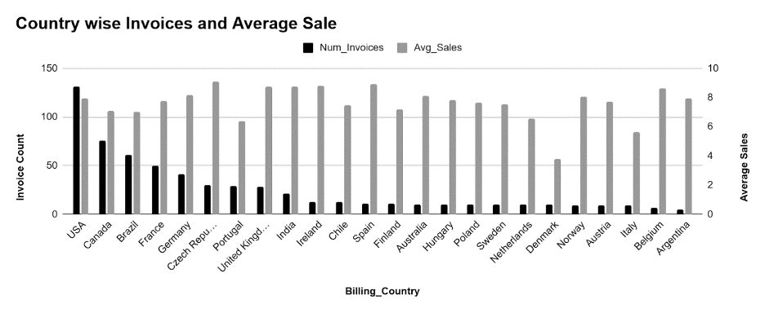
DEMOGRAPHIC ANALYSIS
1. North America: Core Market
●Canada & USA = largest customer base.
●Strong market penetration and success.
2. Europe & South America: Emerging Presence
●Growing customer base in key countries (Brazil, France, Germany, UK).
3. Global Reach: Expansion Opportunities
●Individual customers worldwide.
●Potential for growth, but consider diverse market needs.

Slide 9
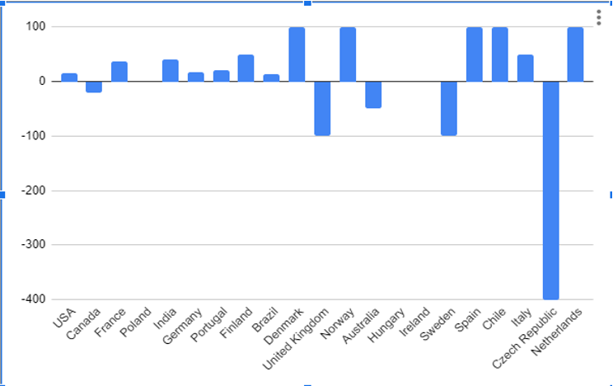
GEOGRAPHICAL ANALYSIS
Churn Rate & Economic Development:
Developed economies (e.g., USA, Canada) show low or negative churn.
Developing economies (e.g., India, Chile) have higher churn.
Business Recommendations:
High-GDP countries: Increase advertising to strengthen market share.
Lower-GDP countries: Offer budget-friendly options to attract and retain customers.

Slide 10
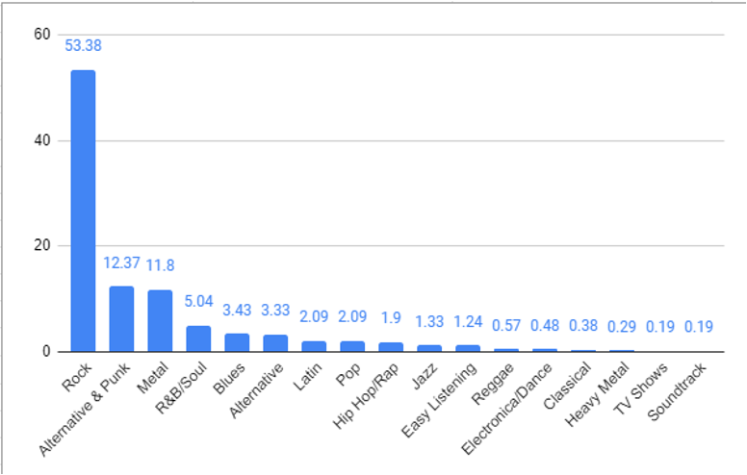
GENRE SALES ANALYSIS
Genre Popularity:
Rock dominates sales (50%+), with Alternative & Punk and Metal also performing strongly.
Business Recommendations:
Prioritize Rock, Alternative & Punk, and Metal in inventory and marketing.
Implement genre-specific promotions to further boost sales.

Slide 11
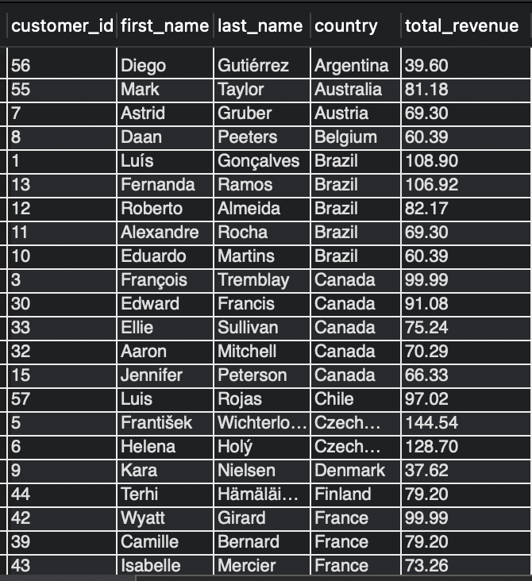
CUSTOMER RISK
Understanding Customer Churn and Spending Behavior
Inactivity Breeds Churn: Longer gaps between purchases increase the likelihood of churn.
Engagement Matters: Frequent buyers are more likely to remain customers.
Spending is a Key Indicator: Low spenders may be at higher risk of churning.
Demographics Play a Role: Age and gender can impact churn and spending, but further analysis is needed.

Slide 12
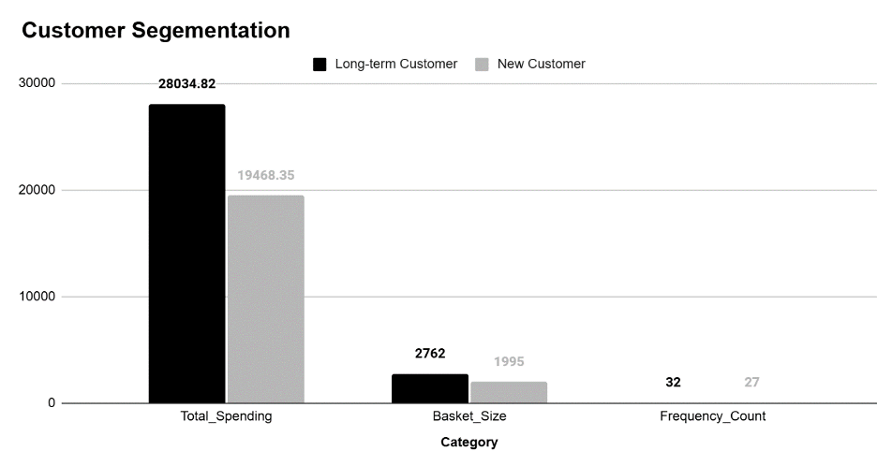
LONG TERM AND SHORT TERM CUSTOMERS
Customer Lifetime Value:
Long-term customers spend more and purchase more items.
Customer retention is crucial for sustained revenue.
Segmentation Opportunity:
Tailor marketing efforts based on customer "term" (e.g., new vs. long-term).
Business Recommendation:
Focus on retention strategies (e.g., loyalty programs, personalized recommendations) to keep customers engaged and coming back.

Slide 13
RECOMMENDATION
Reward Loyalty: Implement loyalty programs to incentivize repeat purchases.
Personalize: Use targeted recommendations and marketing to cater to individual customer preferences.
Excellent Service: Focus on building strong, lasting customer relationships through exceptional service.
Identify & Nurture: Focus on high-value, long-term customers to maximize retention.
Exclusive Benefits: Provide personalized experiences and exclusive perks to enhance customer loyalty.
Regional Campaigns: Customize marketing efforts based on geographical location.
Cultural Sensitivity: Account for language differences and local preferences to enhance engagement.

Slide 14
CONCLUSION
Boost Retention: Implement loyalty programs and personalized marketing to enhance customer retention.
Value High-Value Customers: Offer exclusive deals to long-term, high-value customers.
Data Quality: Maintain accurate data for reliable insights.
Targeted Strategies: Develop region-specific marketing campaigns for better engagement.
Gather More Data: Collect demographic information to refine targeting strategies.
By acting on these insights, Chinook can optimize operations, improve customer engagement, and drive sustainable growth in a competitive market.

Slide 15
THANKS!

